Slide 1
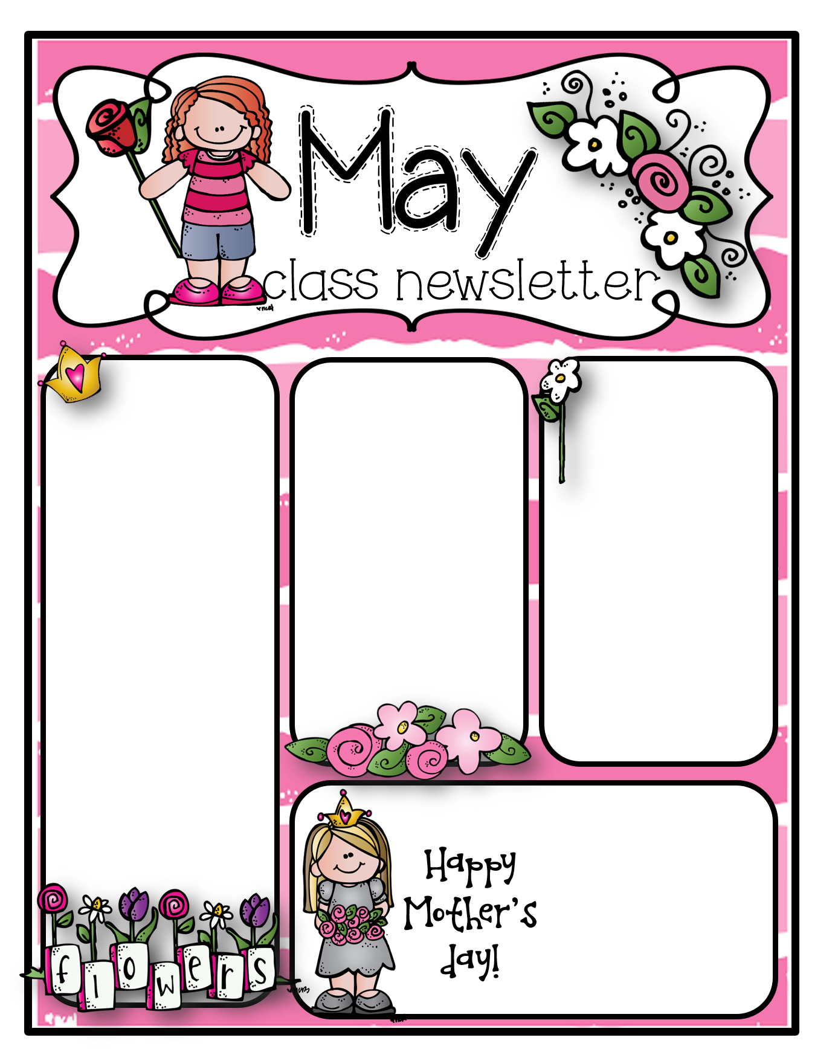
2nd Grade- In Math students are working on measurement.
In Reading students are working on identifying the main idea with key details.
Reminders-
1ST Grade- Continue to work on sight words
2nd Grade- Continue to work on sight words
1st Grade- In Math students are working on missing numbers in a hundred chart, and counting by 2’s
In Reading, students are working on blends and digraphs.
No School-
May 29th

