Slide 1
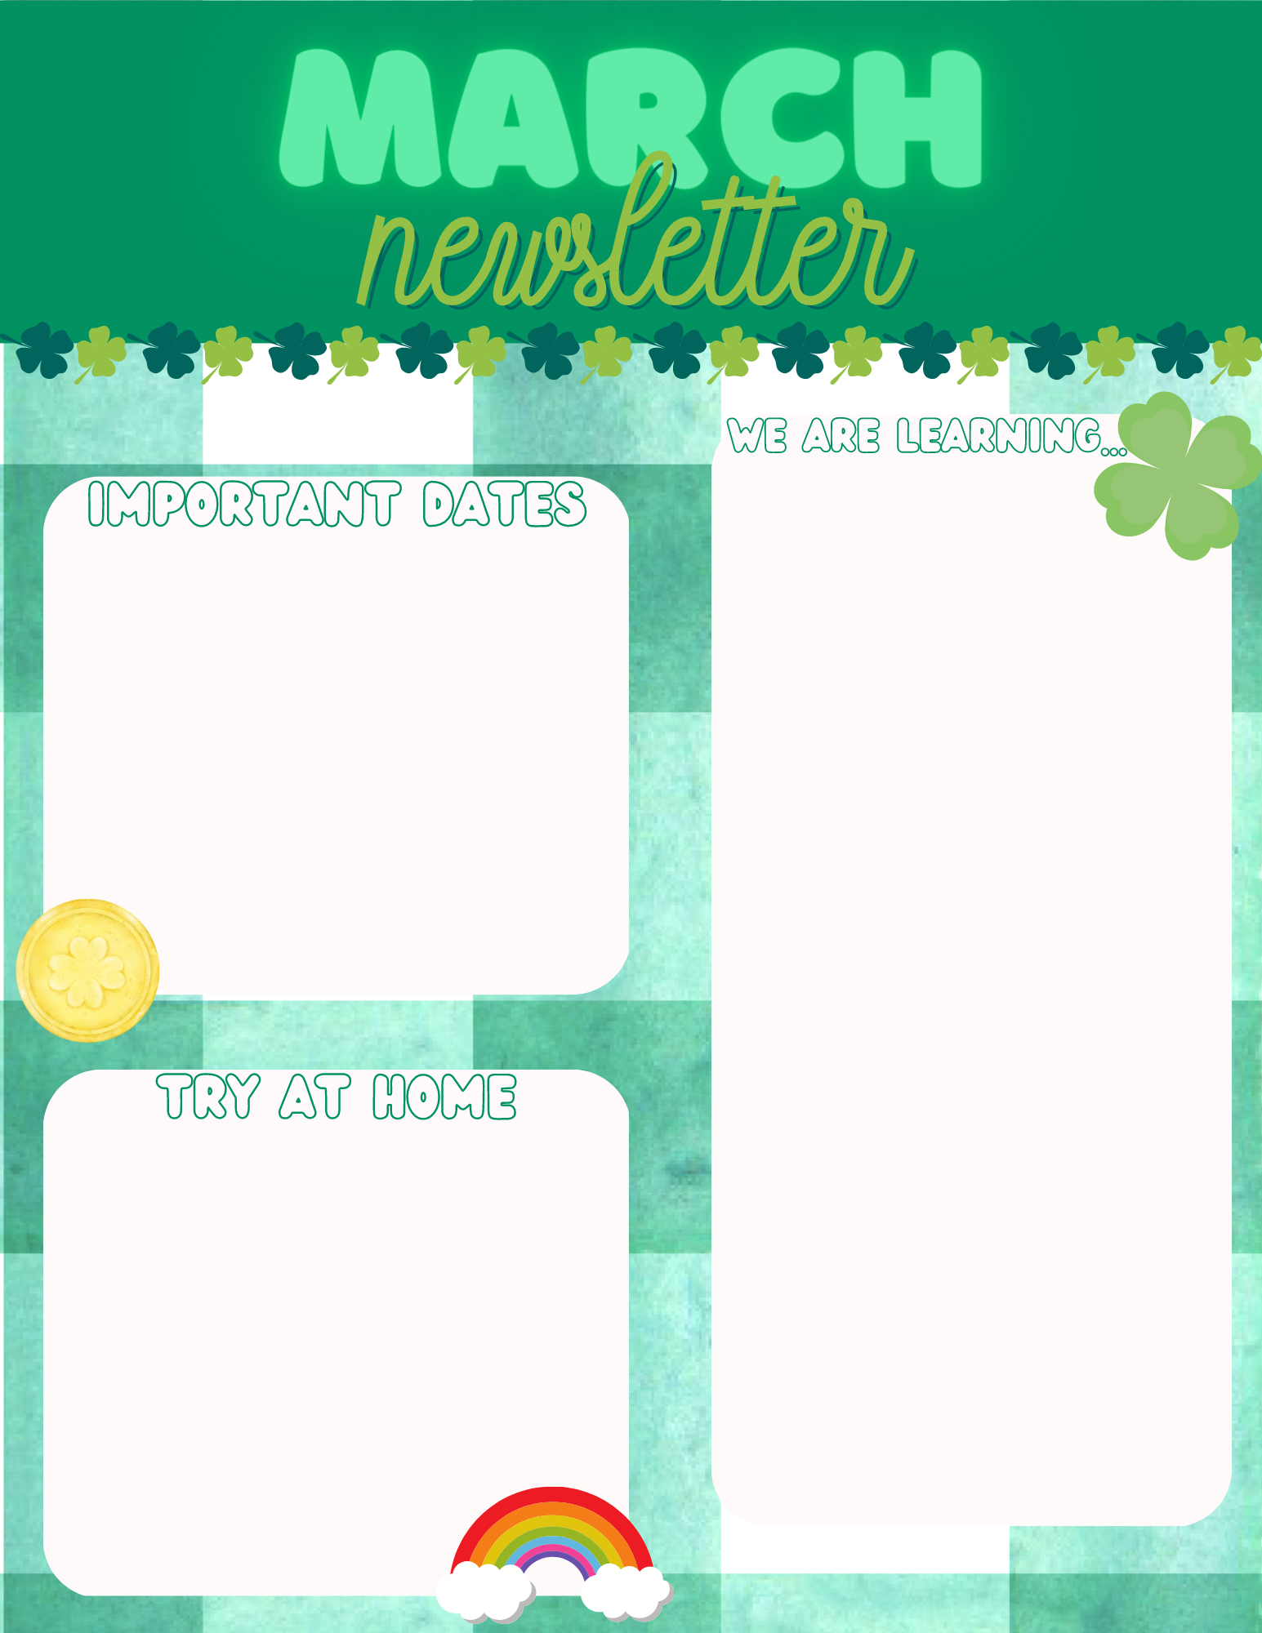
1st Grade Math: Students are working on demonstrating the ability to identify different ways to makes 10.
1st Reading: Students are working on demonstrating the ability to use phonograms and write in complete sentence.
2nd Grade Math: Students are working on organizing data.
2nd Reading: Students are working on identifying antonyms and synonyms.
March 2nd- Reading Night 6:00-8:00
March 16th- Field Trip
March 27th- April 5th- Spring Break
1st Grade- Sight Word Practice
2nd Grade: Weekly Spelling Words

